Slide 1
Smart India Hackathon 2017
Ministry Category : Indian Space Research Organisation (ISRO)
Problem Statement : Storing emails on mailbox server in encrypted format accessible only to owner of the email
Team Leader Name : Anup Kumar Panwar
Problem Code : #ISR1
College Code :
IDEA
Our idea is to develop a SECURED & ENCRYPTED EMAIL SERVICE. Normally Email services provide STORAGE LEVEL ENCRYPTION which are decrypted on-the-fly and that too with a SINGLE KEY. So, we have tackled the drawbacks in this ON-THE-FLY DECRYPTION and SINGLE KEY approach:-
The sender will provide a KEY to lock the Email Content; This key can be anything the BIOMETRICS, a STRING or a FILE. For example, any ISRO research paper can be encrypted with a photo of “Ganesh Ji”. Thereafter that research paper can be opened only if the user has that same “Ganesh Ji” photo with him. But mostly our approach is based on encrypting the content with FINGER PRINTS of the users.
A RANDOM SALT will be generated under MD5 ENCRYPTION ALGORITHM and SERVER TIMESTAMP;
The KEY(Ex: Thumbprint) + SALT will be used to generate an INITIALIZATION VECTOR (IV) that will again undergo MD5 ENCRYPTION;
Then this INITIALIZATION VECTOR will be used to encrypt the email content using AES 128 BIT ENCRYPTION TECHNIQUE;
This Encrypted content will be BASE64 ENCODED and stored in the database. (NOTE : The key provided by the sender is NEVER STORED anywhere in any form)
The recipient of the email will see the content of the email in encrypted form which no one can understand. To read the actual content he has to provide his FINGER PRINTS. This decryption is temporary and at the VIEW LEVEL ONLY . Once the user has read the actual content, as soon as he redirects from the web page. The temporary decryption will vanish.
Now a question might be “Does the receiver needs to remember 100s of passwords for deciphering 100s of emails?” The answer is NO.
Once the recipient has successfully deciphered the email. The key will be stored in user’s LOCAL STORAGE or CACHE, providing DEVICE LEVEL SECURITY as well.
Moreover the sender of the email will get a notification if number of wrong password attempts exceeds a preset value(say 3).The sender and receiver both get an option to delete the email permanently from the server (Even from the receiver’s inbox for the sake of security).
Thus an email service with 3 LAYERS security and encryption : USER AUTHENTICATION, ENCRYPTED STORAGE & DEVICE BASED SECURITY
Technology Stack
HTML, CSS, Material Design Light (MDL), JavaScript, Angular.js, jQuery, PHP, MySQL DB, Mcrypt, AJAX, MD5 Encryption Algorithm, AES 128 bit Encryption Algorithm, PHP Mailer, P2P communication channel, APACHE server, WAMP/LAMP, Web sockets, Ionic Framework, ng-Cordova

Slide 2
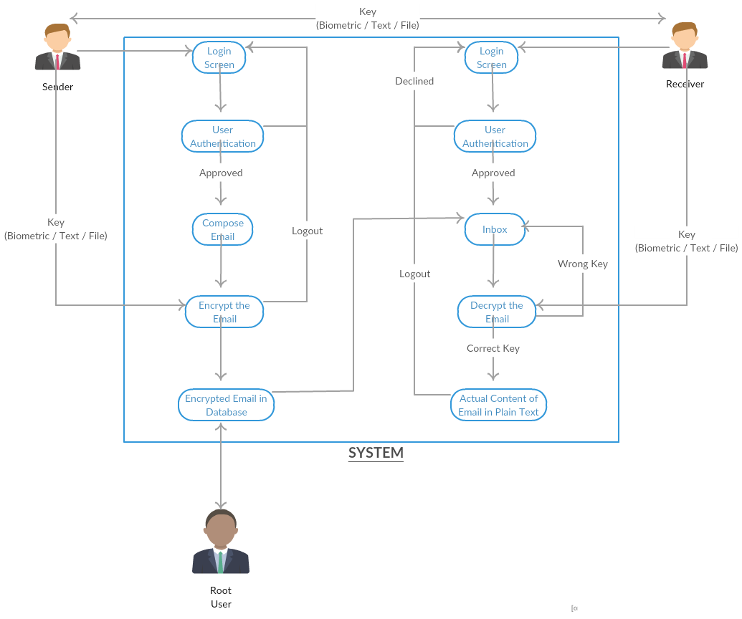
USE CASE
DEPENDENCIES
Android Device with Finger Print Scanner, Biometric Scanner, Internet Connection

Slide 3
a
Use Case
Our Email service can be used for highly confidential information exchange, be that simple text based email or attachment files. Everything on the DB and file storage remains in encrypted format which cannot be access in anyway without knowing the private key set by the sender of that file. For example ISRO can use it for intra-ISRO communications so that information never leaks out. Or defense forces can use it to broadcast message to the soldiers so that only intended person can understand it. Even govt. future plans and RAW’s secret mission information can be carried out through our network. Even sometimes common people lose their cell phones or laptops with their accounts logged in. Our email system is not affected by any hardware thefts, since there is no single key for the encryption. Even shoulder surfing won’t work.

Slide 4
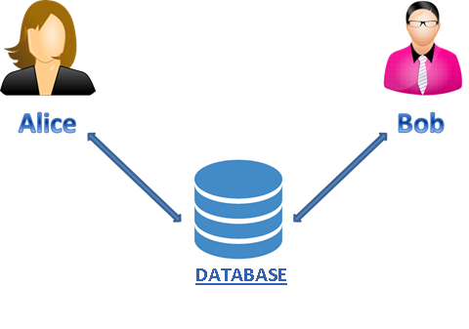



Regular Email Services
Sure ma'am
Hey, Deploy this code.
{
…
code
…
}
{
…
code
…
}
U2FsdGVkX1/adq+2/3BWp7t5QRc0Mh=
Thug Life
{
…
code
…
}
ADMIN

Slide 5
Our Email Service
Sure ma'am
Hey, Deploy this code.
{
…
code
…
}
{
…
code
…
}
U2FsdGVkX1/adq+2/3BWp7t5QRc0Mh=
U2FsdGVkX1/adq+2/3BWp7t5QRc0Mh
ADMIN

Slide 6


No Worry of Confidential Data Leakage, even if someone knows your account password
“What the hell is this? How does he understands these random characters?”
Saw Your Password

Slide 7
IDEA
Our idea is to develop a SECURED & ENCRYPTED EMAIL SERVICE. As the problem statement says that normally Emails services provide STORAGE LEVEL ENCRYPTION which are decrypted on-the-fly. So, we have tackled the drawbacks in this ON-THE-FLY DECRYPTION.
In our approach the email will undergo the following steps for better security :-
The sender will provide a KEY to lock the Email Content;
A RANDOM SALT will be generated under MD5 ENCRYPTION ALGORITHM and SERVER TIMESTAMP;
The KEY + SALT will be used to generate an INITIALIZATION VECTOR (IV) that will again undergo MD5 ENCRYPTION;
Then this INITIALIZATION VECTOR will be used to encrypt the email content using AES 128 BIT ENCRYPTION TECHNIQUE;
Then this Encrypted content will be BASE64 ENCODED and stored in the database. (NOTE : The key provided by the sender is NEVER STORED anywhere in any form)
The recipient of the email will see the content of the email in encrypted form which no one can understand. To read the actual content he has to provide the key which the sender has set. This decryption is temporary and at the VIEW LEVEL ONLY . Once the user has read the actual content, as soon as he redirects from the web page. The temporary decryption will vanish.
Now a question might be “Does the receiver needs to remember 100s of passwords for deciphering 100s of emails?” The answer is NO.
Once the recipient has successfully deciphered the email. The key will be stored in user’s LOCAL STORAGE or CACHE, providing DEVICE LEVEL SECURITY.
Thus an email service with 3 LAYERS security and encryption : USER AUTHENTICATION, ENCRYPTED STORAGE & DEVICE BASED SECURITY

